Slide 1
SIT113 Cloud Computing and Virtualisation
Week 8, Class 2
Cloud Architectures

Slide 2
Outline
Advanced Cloud Architectures (Chapter 12)
Hypervisor Clustering Architecture
Load Balanced Virtual Server Instances Architecture
Non-Disruptive Service Relocation Architecture
Zero Downtime Architecture
Cloud Balancing Architecture
Resource Reservation Architecture
Dynamic Failure Detection and Recovery Architecture
Bare-Metal Provisioning Architecture
Rapid Provisioning Architecture
Storage Workload Management Architecture

Slide 3
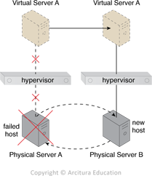
Hypervisor Clustering Architecture
establishes a high-availability cluster of hypervisors across multiple physical servers

Slide 4
Hypervisor Clustering Architecture
Additional Mechanisms
Logical Network Perimeter
Resource Replication
Heartbeat messages
VIM (Virtualised Infrastructure Manager)

Slide 5
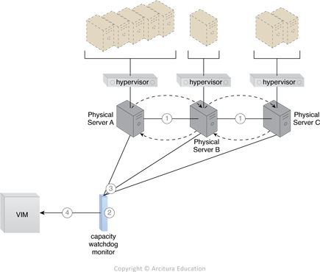
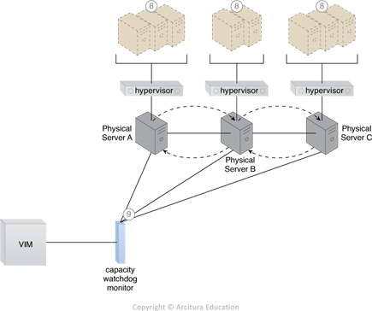
Load Balanced Virtual Server Instances Architecture
dynamically calculates virtual servers and workloads
then distributes processing across physical servers

Slide 6
Load Balanced Virtual Server Instances Architecture
Additional Mechanisms
Automated Scaling Listener
Logical Network Perimeter
Resource Replication

Slide 7
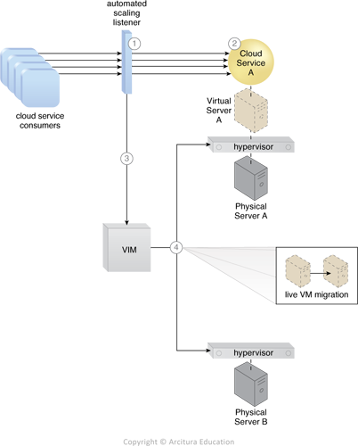
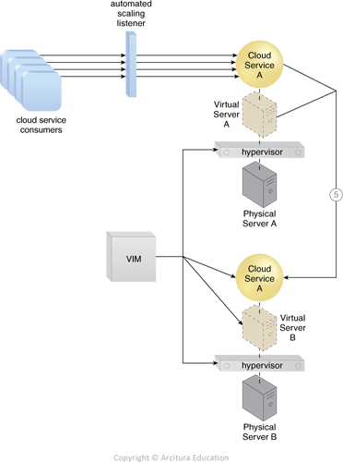
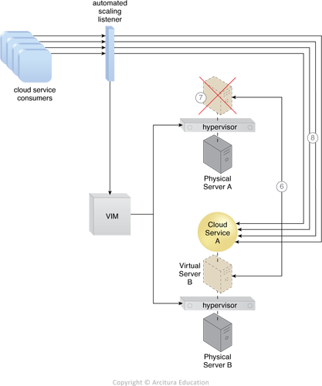
Non-Disruptive Service Relocation Architecture
predefined events trigger duplication or migration of a cloud service at runtime to avoid disruption

Slide 8
Non-Disruptive Service Relocation Architecture
Additional Mechanisms
Cloud Usage Monitor
Pay-Per-Use Monitor
Resource Replication
SLA Management System: processes SLA data to obtain cloud service availability assurances
SLA Monitor: collects SLA information required by the SLA management system

Slide 9
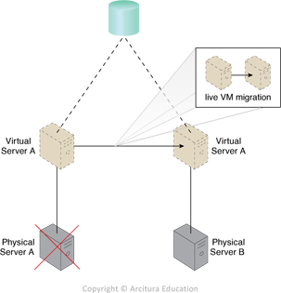
Zero Downtime Architecture
virtual servers can be moved dynamically to different physical server hosts, in the event that their original physical server host fails

Slide 10
Zero Downtime Architecture
Additional Mechanisms
Audit Monitor
Cloud Usage Monitor
Hypervisor
Logical Network Perimeter
Resource Replication
Resource Cluster: creates active-active cluster groups to improve availability

Slide 11
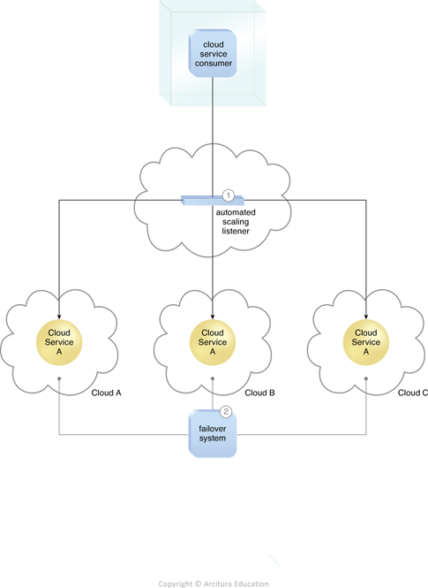
Cloud Balancing Architecture
load balances IT resources across multiple clouds

Slide 12
Cloud Balancing Architecture
Additional Mechanisms
Automated Scaling Listener (ASL)
Failover System:
ensures redundant IT resources are capable of cross-cloud failover
notifying the ASL of any failures to ensure requests aren’t routed to unavailable/unstable IT resources

Slide 13
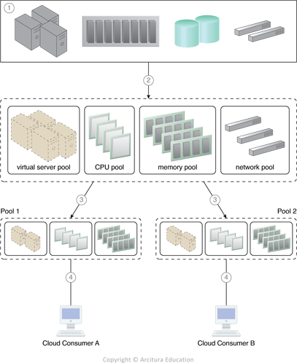
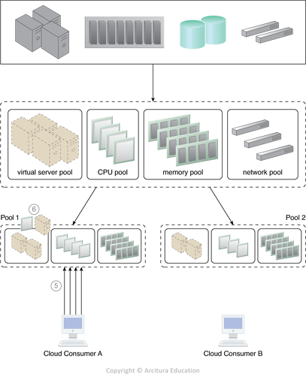
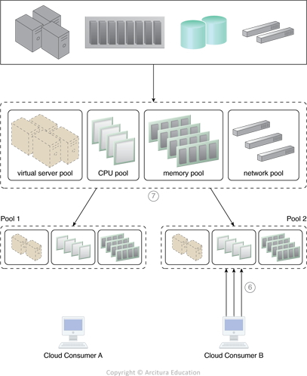
Resource Reservation Architecture
IT resources are partly or wholly set aside for the exclusive use of a cloud consumer

Slide 14
Resource Reservation Architecture
Additional Mechanisms
Audit Monitor
Cloud Usage Monitor
Hypervisor
Logical Network Perimeter
Resource Replication

Slide 15
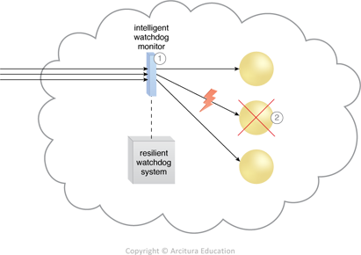
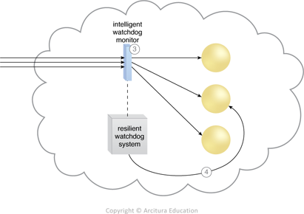
Dynamic Failure Detection and Recovery Architecture
monitors/responds to pre-defined failure scenarios
escalates failure conditions that cannot be automatically resolved

Slide 16
Dynamic Failure Detection and Recovery Architecture
Additional Mechanisms
Audit Monitor
Failover System
SLA Management System
SLA Monitor

Slide 17
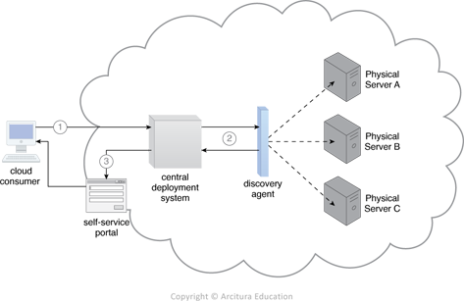
Bare-Metal Provisioning Architecture
provides remote control of systems with no operating system installed

Slide 18
Bare-Metal Provisioning Architecture
Additional Mechanisms
Hypervisor
Logical Network Perimeter
Resource Replication
SLA Management System
Cloud Storage Device: stores operating system templates and installation files, deployment agents and deployment packages

Slide 19
Rapid Provisioning Architecture
automates provisioning of a wide range of IT resources, either individually or collectively
Server Templates: virtual image files that automate creation of new virtual servers
Server Images: similar to templates, but used to provision physical servers
Application Packages: applications and other software for automated deployment

Slide 20
Rapid Provisioning Architecture
Application Packager: software for creating application packages
Custom Scripts: automate administrative tasks
Sequence Manager: organises a sequence of automated provisioning tasks
Sequence Logger: logs execution of automated provisioning sequences

Slide 21
Rapid Provisioning Architecture
Operating System/Application Configuration Baselines: configurations applied to operating systems and applications automatically after installation to prepare them for use
Deployment Data Store: repository of virtual images, templates, scripts, baseline configurations, and other related data.

Slide 22
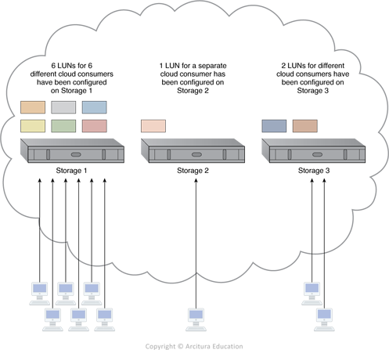
Storage Workload Management Architecture
enables LUNs (virtual disk/partition) to be evenly distributed across available cloud storage devices

Slide 23
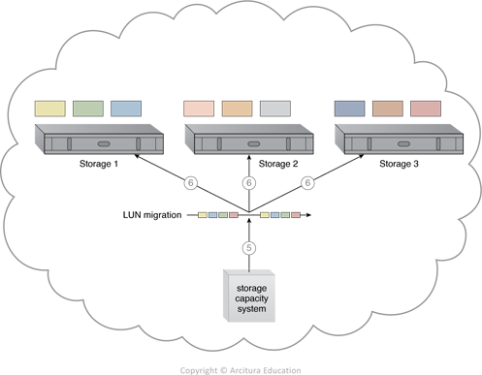
Storage Workload Management Architecture
migration of LUNs for even distribution

Slide 24
Storage Workload Management Architecture
Additional Mechanisms
Audit Monitor
Automated Scaling Listener
Cloud Usage Monitor
Load Balancer
Logical Network Perimeter

Slide 25
Summary
Advanced Cloud Architectures
Hypervisor Clustering Architecture
Load Balanced Virtual Server Instances Architecture
Non-Disruptive Service Relocation Architecture
Zero Downtime Architecture
Cloud Balancing Architecture
Resource Reservation Architecture
Dynamic Failure Detection and Recovery Architecture
Bare-Metal Provisioning Architecture
Rapid Provisioning Architecture
Storage Workload Management Architecture

